Slide 1





Visualización de Datos y Narración de Historias
00 Información general del curso
Edgar Avalos-Gauna, PhD.
edgaravalos@up.edu.mx
www.linkedin.com/in/e-avalos-gauna/

Slide 2













BEng in Industrial Engineering (2004-2008)
MSc in Mechanical Engineering (2009-2011)
PhD in Mechanical Engineering (2013-2017)
Postdoctoral position in Data Science (2018-2019)
Member of the National System of Researchers (C – SNI)
Member of the Mexican Society of Artificial Intelligence (SMIA)
Member of the IEEE since 2019
Member of ACM since 2020
Member of ASME since 2023
14 published articles/conference papers

Slide 3











BEng in Industrial Engineering (2004-2008)
MSc in Mechanical Engineering (2009-2011)
PhD in Mechanical Engineering (2013-2017)
Postdoctoral position in Data Science (2018-2019)
Member of the National System of Researchers (C – SNI)
Member of the Mexican Society of Artificial Intelligence (SMIA)
Member of the IEEE since 2019
Member of ACM since 2020
Member of ASME since 2023
14 published articles/conference papers

Slide 4
BEng in Industrial Engineering (2004-2008)
MSc in Mechanical Engineering (2009-2011)
PhD in Mechanical Engineering (2013-2017)
Postdoctoral position in Data Science (2018-2019)
Member of the National System of Researchers (C – SNI)
Member of the Mexican Society of Artificial Intelligence (SMIA)
Member of the IEEE since 2019
Member of ACM since 2020
Member of ASME since 2023
14 published articles/conference papers

Slide 5
BEng in Industrial Engineering (2004-2008)
MSc in Mechanical Engineering (2009-2011)
PhD in Mechanical Engineering (2013-2017)
Postdoctoral position in Data Science (2018-2019)
Member of the National System of Researchers (C – SNI)
Member of the Mexican Society of Artificial Intelligence (SMIA)
Member of the IEEE since 2019
Member of ACM since 2020
Member of ASME since 2023
14 published articles/conference papers

Slide 6

BEng in Industrial Engineering (2004-2008)
MSc in Mechanical Engineering (2009-2011)
PhD in Mechanical Engineering (2013-2017)
Postdoctoral position in Data Science (2018-2019)
Member of the National System of Researchers (C – SNI)
Member of the Mexican Society of Artificial Intelligence (SMIA)
Member of the IEEE since 2019
Member of ACM since 2020
Member of ASME since 2023
14 published articles/conference papers

Slide 7





Lineamientos para una correcta sesión en línea
Mar 7:05pm – 9:40pm hora CDMX, con un descanso de 10 minutos (8:20pm).
Se espera cortesía y respeto entre todos los participantes.
Evita estar realizando actividades de manera simultánea ajenas a la clase que pudieran distraerte.
Asegúrate de tener el micrófono apagado (excepto en caso de dudas) y la cámara encendida durante las sesiones.

Slide 8



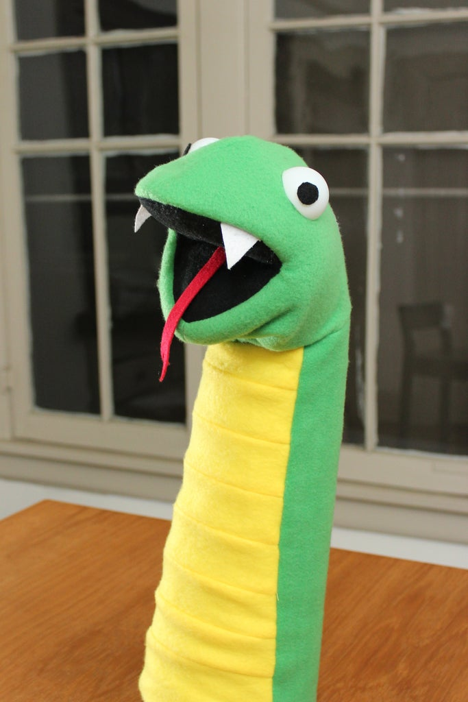
Course Github
edavgaun
https://github.com/edavgaun/
print(“Hello World!”)

Slide 9

Syllabus
2. Técnicas y herramientas para la visualización de datos
3. Principales retos
4. Visualización de datos eficaz
1. Introducción

Slide 10
Sistema de evaluación
Un Kahoot al final de cada 2 módulos (2)
Quizzes 20%
Proyecto 50%
Colab notebooks 30%
3 Actividades para desarrollar en Colab notebooks
Presentación sobre un tema a escoger utilizando las técnicas vistas en clase

Slide 11

Evaluación proyecto
Análisis del problema
Conjunto de datos elegido
Metadatos
Hipótesis para evaluar
EDA
Una presentación de discurso de ascensor (máx. 5 +- 1 min)

Slide 12
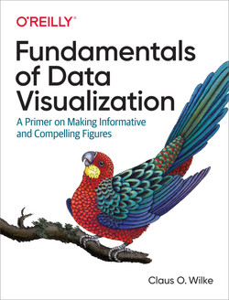
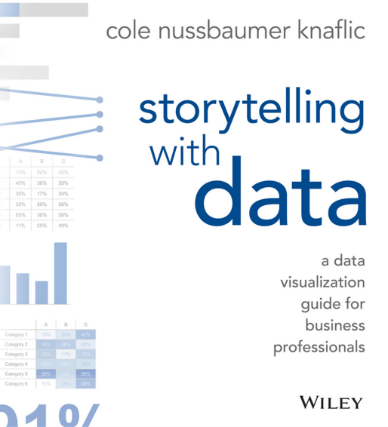
Bibliografía sugerida
https://clauswilke.com/dataviz/

Slide 13

Student Outcomes
Desarrollar una mentalidad orientada a los datos
Implementar visualizaciones en combinación con estadísticas como parte del proceso de toma de decisiones
Distinguir entre tipos de datos y técnicas de visualización
Incorporar la narrativa más adecuada para cada situación

Slide 14
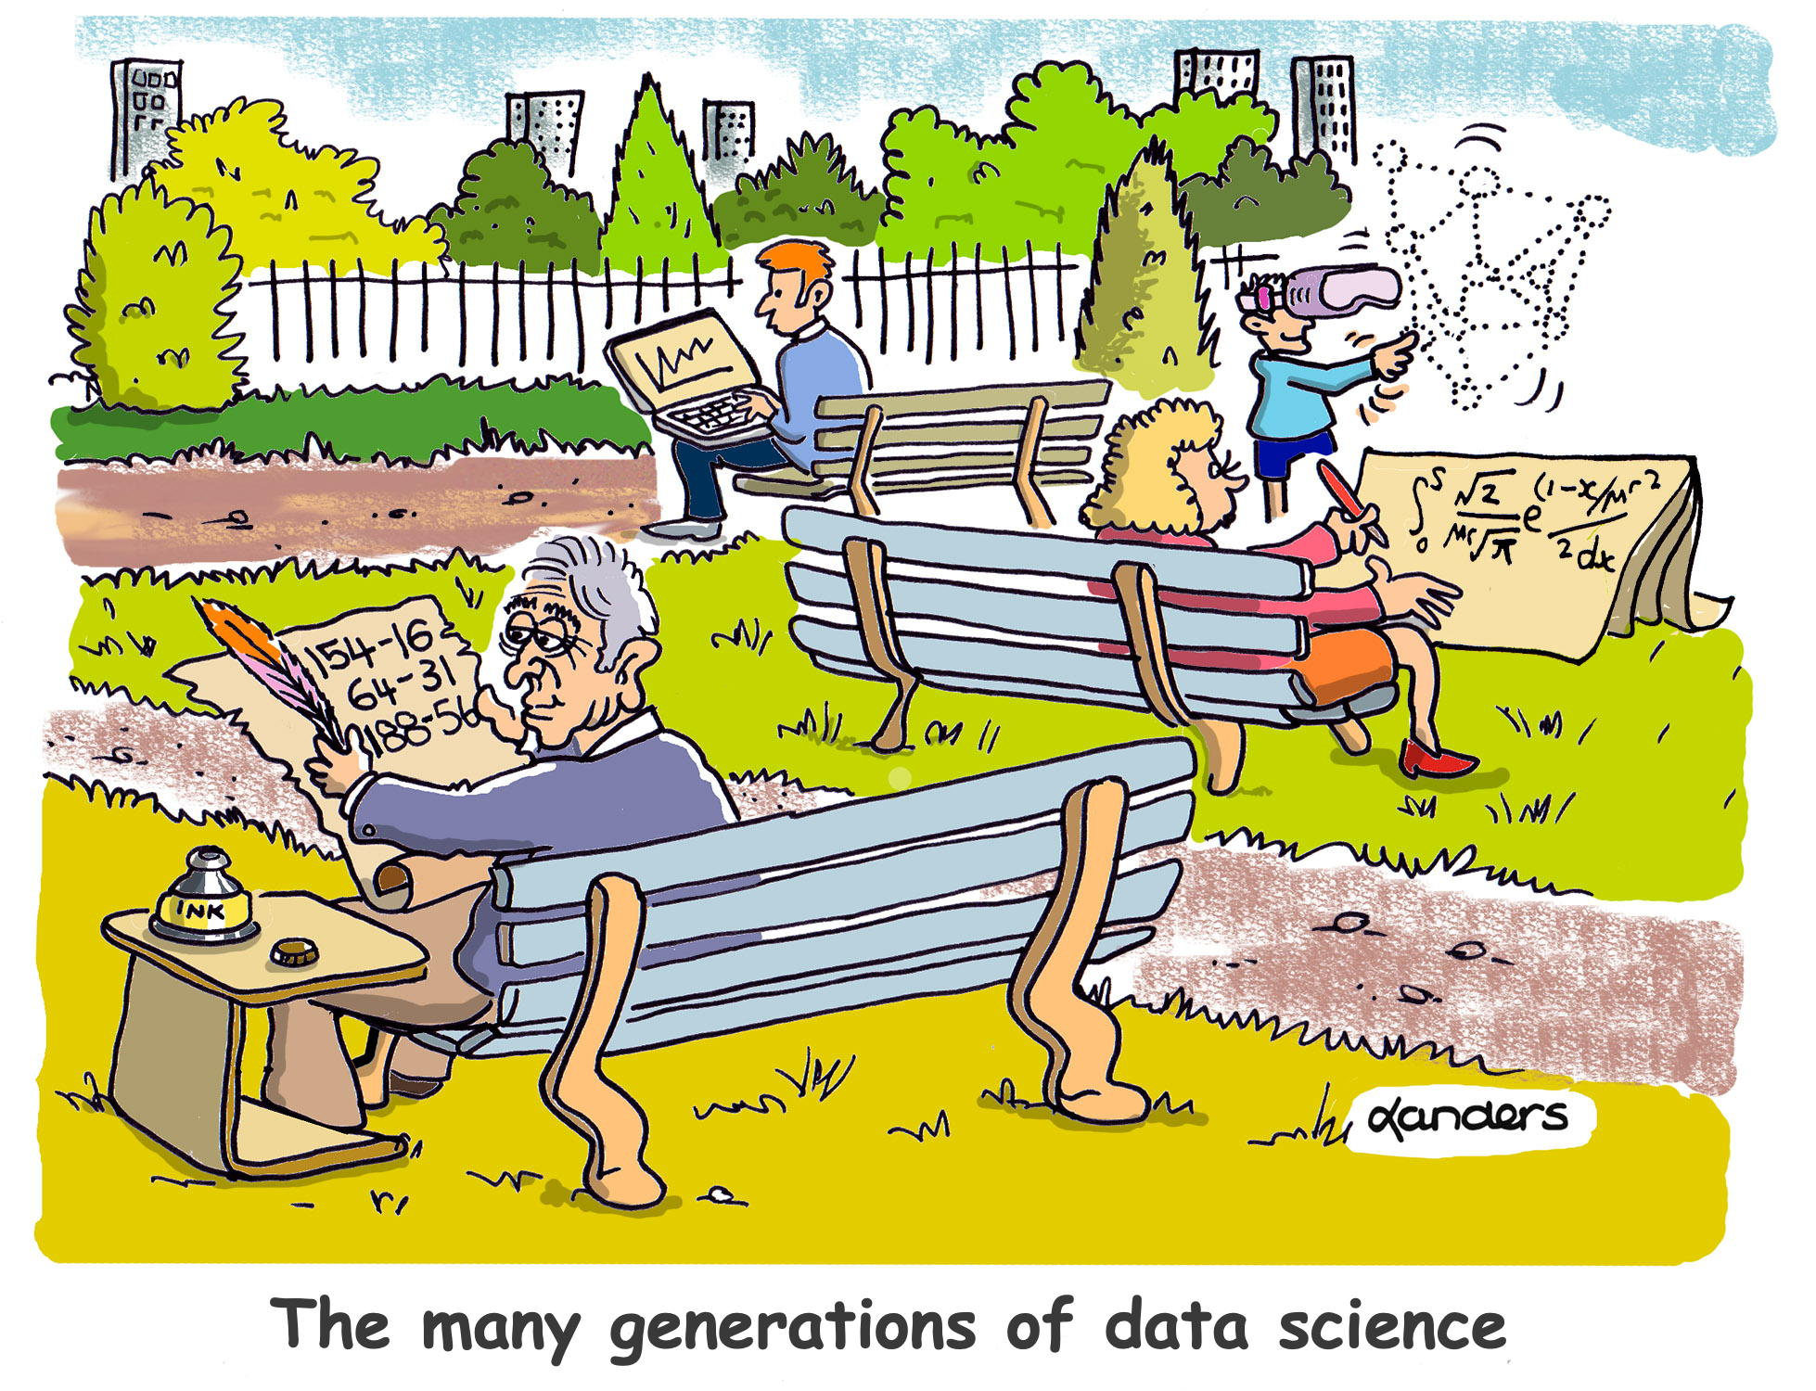
Are you familiar with the “Frequency illusion”?
The Baader–Meinhof phenomenon

Slide 15
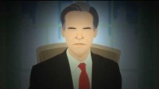

Persuasion and the Power of Story: Jennifer Aaker
(Future of StoryTelling 2013)

